Slide 1
Machine Learning
(Reasoning under Uncertainty)

Slide 2
Learning
It is often hard to articulate the knowledge we need to build AI systems.
Often, we don’t even know it!
Frequently, we can arrange to build systems that learn it themselves
Notes:
Even though we want to build AI systems, it's often difficult to clearly define the exact knowledge we need to give them.
Implicit Knowledge: A lot of human knowledge is implicit, meaning it's not explicitly stated. We can perform actions or understand situations without necessarily being able to explain every step in detail. For example, riding a bike requires balancing, turning, and pedaling, but we might not be able to explain exactly how we do it all at once. AI systems need this kind of knowledge translated into a way they can understand and use.
Unidentified Needs: As we build AI, we might discover entirely new types of knowledge the system needs that we hadn't considered before. This can be a challenge because how can you define something you don't even know exists? Formalizing Knowledge: Even for knowledge we can explain, expressing it in a way a computer can understand can be tricky. Our language has complexities and nuances that aren't easy to translate into computer code.
So far, we have talked a lot about building systems that have knowledge represented in them explicitly. One way to acquire that knowledge is to build it in by hand. But that can be timeconsuming and error prone. And many times, humans just don't have the relevant information available to them.
For instance, you are all experts in visual object recognition. But it's unlikely that you could sit down and write a program that would do the job even remotely as well as you can.
But, in lots of cases, when we don't have direct access to a formal description of a problem, we can learn something about it from examples.

Slide 3
What is Learning?
Memorizing something
Learning facts through observation and exploration
Improving motor and/or cognitive skills through practice
Organizing new knowledge into general, effective representations
“Learning denotes changes in the system that are adaptive in the sense that they enable the system to do the task or tasks drawn from the same population more efficiently and more effectively the next time.” -- Herb Simon
Notes:
The word "learning" has many different meanings. It is used, at least, to describe
● memorizing something
● learning facts through observation and exploration
● development of motor and/or cognitive skills through practice
● organization of new knowledge into general, effective representations
Herb Simon (an important historical figure in AI and in Economics) gave us this definition of learning:
Learning denotes changes in the system that are adaptive in the sense that they enable the system to do the task or tasks drawn from the same population more efficiently and more effectively the next time.
This is not entirely precise, but it gives us the idea that learning systems have to acquire some information from examples of a problem, and perform better because of it (so we wouldn't call a system that simply logs all the images it has ever seen a learning system, because, although, in some sense, it knows a lot, it can't take advantage of its knowledge)

Slide 4
Induction
Piece of bread number 1 was nourishing when I ate it.
Piece of bread number 2 was nourishing when I ate it.
…
Piece of bread number 100 was nourishing when I ate it.
Therefore, all pieces of bread will be nourishing if I eat them.
David Hume
Notes:
One of the most common kinds of learning is the acquisition of information with the goal of making predictions about the future. But what exactly gives us license to imagine we can predict the future? Lots of philosophers have thought about this problem. David Hume first framed the problem of induction as follows:
● Piece of bread number 1 was nourishing when I ate it.
● Piece of bread number 2 was nourishing when I ate it.
● Piece of bread number 3 was nourishing when I ate it.
● Piece of bread number 100 was nourishing when I ate it.
● Therefore, all pieces of bread will be nourishing if I eat them.

Slide 5
Induction
Induction reasoning is a way of thinking where you draw conclusions based on specific observations.
Induction reasoning starts with specific observations or examples.
You then identify patterns or commonalities across those examples.
Based on these patterns, you form a general conclusion that applies to a broader category.
Notes:
Imagine you see several swans in your life, and all of them are white. Through inductive reasoning, you might conclude that all swans are white. This conclusion is based on the specific observations you've made, but it might not be entirely true (there are black swans after all!).

Slide 6
Why is Induction Okay?
It has been argued that we have reason to know the future will resemble the past, because what was the future has constantly become the past, and has always been found to resemble the past, so that we really have experience of the future, namely of times which were formerly future, which we may call past futures. But such an argument really begs the very question at issue. We have experience of past futures, but not of future futures, and the question is: Will future futures resemble past futures?
Bertrand Russell'
Notes:
When and why is it okay to apply inductive reasoning?? My favorite quote on the subject is the following, exerpted from Bertrand Russell's "On Induction":
If asked why we believe the sun will rise tomorrow, we shall naturally answer, 'Because it has always risen every day.' We have a firm belief that it will rise in the future, because it has risen in the past.
The real question is: Do any number of cases of a law being fulfilled in the past afford evidence that it will be fulfilled in the future?

Slide 7
Kinds of Learning
Supervised Learning: given a set of example input/output pairs, find a rule that does a good job of predicting the output associated with a new input.
Unsupervised Learning (Clustering): given a set of examples, but no labelling of them, group the examples into “natural” clusters.
Reinforcement Learning: an agent interacting with the world makes observations, takes actions, and is rewarded or punished; it should learn to choose actions in such a way as to obtain a lot of reward.
Notes:
When viewed technically, there are lots of different kinds of machine learning problems. We'll just sketch them out here, so you get an idea of their range.
Supervised learning is the most common learning problem. Let's say you are given the weights and lengths of a bunch of individual salmon fish, and the weights and lengths of a bunch of individual tuna fish. The job of a supervised learning system would be to find a predictive rule that, given the weight and length of a fish, would predict whether it was a salmon or a tuna.
Another, somewhat less well-specified, learning problem is clustering. Now you're given the descriptions of a bunch of different individual animals (or stars, or documents) in terms of a set of features (weight, number of legs, presence of hair, etc), and your job is to divide them into groups, or possibly into a hierarchy of groups that "makes sense". What makes this different from supervised learning is that you're not told in advance what groups the animals should be put into; just that you should find a natural grouping.
Another learning problem, familiar to most of us, is learning motor skills, like riding a bike. We call this reinforcement learning. It's different from supervised learning because no-one explicitly tells you the right thing to do; you just have to try things and see what makes you fall over and what keeps you upright.
Supervised learning is the most straightforward, prevalent, and well-studied version of the learning problem, so we are going to start with it, and spend most of our time on it. Most of the fundamental insights into machine learning can be seen in the supervised case.

Slide 8
Differences between Kinds of Learning
Supervision:
Supervised learning relies on labelled data for guidance, while unsupervised learning and reinforcement learning do not.
Learning Goal:
Supervised learning aims for prediction, unsupervised learning seeks to understand patterns, and reinforcement learning focuses on optimal decision-making.
Data Interaction:
Supervised learning uses static data for training, unsupervised learning analyses the data itself, and reinforcement learning involves an ongoing interaction with an environment.
Notes:
When viewed technically, there are lots of different kinds of machine learning problems. We'll just sketch them out here, so you get an idea of their range.
Supervised learning is the most common learning problem. Let's say you are given the weights and lengths of a bunch of individual salmon fish, and the weights and lengths of a bunch of individual tuna fish. The job of a supervised learning system would be to find a predictive rule that, given the weight and length of a fish, would predict whether it was a salmon or a tuna.
Another, somewhat less well-specified, learning problem is clustering. Now you're given the descriptions of a bunch of different individual animals (or stars, or documents) in terms of a set of features (weight, number of legs, presence of hair, etc), and your job is to divide them into groups, or possibly into a hierarchy of groups that "makes sense". What makes this different from supervised learning is that you're not told in advance what groups the animals should be put into; just that you should find a natural grouping.
Another learning problem, familiar to most of us, is learning motor skills, like riding a bike. We call this reinforcement learning. It's different from supervised learning because no-one explicitly tells you the right thing to do; you just have to try things and see what makes you fall over and what keeps you upright.
Supervised learning is the most straightforward, prevalent, and well-studied version of the learning problem, so we are going to start with it, and spend most of our time on it. Most of the fundamental insights into machine learning can be seen in the supervised case.

Slide 9
Learning a Function
Given a set of examples of input/output pairs, find a function that does a good job of expressing the relationship
Pronunciation: function from letters to sounds.
Throw a ball: function from target locations to joint torques
Read handwritten characters: function from collections of image pixels to letters
Diagnose diseases: function from lab test results to disease categories
Notes:
One way to think about learning is that you're trying to find the definition of a function, given a bunch of examples of its input and output. This might seem like a pretty narrow definition, but it actually covers a lot of cases.
● Learning how to pronounce words can be thought of as finding a function from letters to sounds.
● Learning how to throw a ball can be thought of as finding a function from target locations to joint torques.
● Learning to recognize handwritten characters can be thought of as finding a function from collections of image pixels to letters.
● Learning to diagnose diseases can be thought of as finding a function from lab test results to disease categories.

Slide 10
Aspects of Function Learning
Memory
Averaging
Generalisation
Notes:
Machine Learning: In machine learning, a function is often an algorithm used to make predictions or classifications. Function learning here involves training a model to perform a specific task, like image recognition.
The problem of learning a function from examples, is complicated. You can think of at least three different problems being involved: memory, averaging, and generalization. We'll look at each of these problems, by example.

Slide 11
Example Problem
When to drive the car? Depends on:
Temperature
Expected precipitation
Day of the week
Whether she needs to shop on the way home
What she’s wearing
Notes:
We'll do this in the context of a silly example problem. Imagine that I'm trying predict whether my neighbor is going to drive into work tomorrow, so I can ask for a ride. Whether she drives into work seems to depend on the following attributes of the day: the temperature, what kind of precipitation is expected, the day of the week, whether she needs to shop on the way home, and what she's wearing

Slide 12
Memory
Temp | Precip | Day | Shop | Clothes
39 | none | Saturday | No | Casual | Walk
10 | Rain | Monday | Yes | Casual | Drive
21 | None | Tuesday | No | Casual | Walk
Notes:
Okay. Let's say we observe our neighbor on three days, which are described in the table, which specifies the properties of the days and whether or not the neighbor walked or drove.

Slide 13
Memory
Temp | Precip | Day | Shop | Clothes
39 | none | Saturday | No | Casual | Walk
10 | Rain | Monday | Yes | Casual | Drive
21 | None | Tuesday | No | Casual | Walk
10 | Rain | Monday | Yes | Casual
Notes:
The standard answer in this case is "yes". This day is just like one of the ones we've seen before, and so it seems like a good bet to predict "yes." This is about the most rudimentary form of learning, which is just to memorize the things you've seen before. Still, it can help you do a better job in the future, if those same cases arise again.

Slide 14
Memory
Temp | Precip | Day | Shop | Clothes
39 | none | Saturday | No | Casual | Walk
10 | Rain | Monday | Yes | Casual | Drive
21 | None | Tuesday | No | Casual | Walk
10 | Rain | Monday | Yes | Casual | Drive
Notes:
Now, we find ourselves on a rainy 10-degree Monday, when the neighbor is wearing casual clothes and going shopping. Do you think she's going to drive?
The standard answer in this case is "yes". This day is just like one of the ones we've seen before, and so it seems like a good bet to predict "yes." This is about the most rudimentary form of learning, which is just to memorize the things you've seen before. Still, it can help you do a better job in the future, if those same cases arise again.

Slide 15
Averaging
Dealing with noise data
Temp | Precip | Day | Shop | Clothes
39 | none | Saturday | No | Casual | Walk
39 | none | Saturday | No | Casual | Walk
39 | none | Saturday | No | Casual | Drive
39 | none | Saturday | No | Casual | Drive
39 | none | Saturday | No | Casual | Walk
39 | none | Saturday | No | Casual | Walk
39 | none | Saturday | No | Casual | Walk
39 | none | Saturday | No | Casual
Notes:
Now, we ask you to predict what's going to happen. You've certainly seen this case before. But the problem is that it has had different answers. Our neighbor is not entirely reliable.

Slide 16
Averaging
Dealing with noise data
Temp | Precip | Day | Shop | Clothes
39 | none | Saturday | No | Casual | Walk
39 | none | Saturday | No | Casual | Walk
39 | none | Saturday | No | Casual | Drive
39 | none | Saturday | No | Casual | Drive
39 | none | Saturday | No | Casual | Walk
39 | none | Saturday | No | Casual | Walk
39 | none | Saturday | No | Casual | Walk
39 | none | Saturday | No | Casual | Walk
Notes:
There are a couple of plausible strategies here. One would be to predict the majority outcome. The neighbor walked more times than she drove in this situation, so we might predict "walk". Another option would be to decline to commit to one prediction, but to generate a probability instead. You might answer that you think, with probability 5/7, she will walk.
In this course, we'll give a treatment of machine learning that doesn't really rely on probability. But in many cases, the algorithms and concepts we talk about have probabilistic foundations, and there are many more sophisticated techniques that rely on a deep understanding of probability. So, if you like machine learning, take probability, and then take the machine learning class!

Slide 17
Sensor Noise
Dealing with noise data
Temp | Precip | Day | Shop | Clothes
38 | none | Saturday | No | Casual | Walk
40 | none | Saturday | No | Casual | Walk
36 | none | Saturday | No | Casual | Walk
12 | none | Saturday | No | Casual | Drive
9 | none | Saturday | No | Casual | Drive
10 | none | Saturday | No | Casual | Drive
11 | none | Saturday | No | Formal | Drive
Notes:
Here's another situation in which noise is an issue. This time, the noise has corrupted our descriptions of the situation (our thermometer is somewhat unreliable, as is our ability to assess the formality of the neighbor's clothing, given her peculiar taste).

Slide 18
Sensor Noise
Dealing with noise data
Temp | Precip | Day | Shop | Clothes
38 | none | Saturday | No | Casual | Walk
40 | none | Saturday | No | Casual | Walk
36 | none | Saturday | No | Casual | Walk
12 | none | Saturday | No | Casual | Drive
9 | none | Saturday | No | Casual | Drive
10 | none | Saturday | No | Casual | Drive
11 | none | Saturday | No | Formal | Drive
10 | none | Saturday | No | Casual | Drive
Notes:
In this case, we'd like to recognize that the day that we're asked to do the prediction for is apparently similar to cases we've seen before. It is ultimately impossible to tell whether this day is really different from those other days, or whether our sensors are just acting up. We'll just have to accept that uncertainty.
So, we'll have to treat this as an instance of the more general problem of generalization.

Slide 19
Generalization
Dealing with previously unseen cases
Temp | Precip | Day | Shop | Clothes
36 | None | Friday | Yes | Formal | Drive
18 | None | Sunday | Yes | Casual | Walk
32 | Rain | Wednesday | No | Casual | Walk
47 | None | Monday | No | Casual | Drive
27 | None | Saturday | No | Formal | Drive
40 | None | Saturday | No | Casual | Walk
9 | Snow | Monday | Yes | Casual | Drive
32 | None | Tuesday | No | Casual | Walk
Notes:
Take a look at this data set

Slide 20
Generalization
Dealing with previously unseen cases
Temp | Precip | Day | Shop | Clothes
36 | None | Friday | Yes | Formal | Drive
18 | None | Sunday | Yes | Casual | Walk
32 | Rain | Wednesday | No | Casual | Walk
47 | None | Monday | No | Casual | Drive
27 | None | Saturday | No | Formal | Drive
40 | None | Saturday | No | Casual | Walk
9 | Snow | Monday | Yes | Casual | Drive
32 | None | Tuesday | No | Casual | Walk
29 | rain | Monday | No | Casual | ____
Notes:
Now, consider this day. It's 58 degrees and raining on a Monday. The neighbor is wearing casual clothing and doesn't need to shop. Will she walk or drive?
The first thing to observe is that there's no obviously right answer. We have never seen this case before. We could just throw up our hands and decline to make a prediction. But ultimately, we have to decide whether or not to call the neighbor. So, we might fall back on some assumptions about the domain. We might assume, for instance, that there's a kind of smoothness property: similar situations will tend to have similar categories.
You might plausibly make any of the following arguments:
● She's going to walk because it's raining today and the only other time it rained, she walked.
● She's going to drive because she has always driven on Mondays.
● She's going to walk because she only drives if she is wearing formal clothes, or if the temperature is above 90 or below 20.
The question of which one to choose is hard. It's one of the deep underlying problems of machine learning. We'll look at some examples to try to get more intuition, then come back and revisit it a bit

Slide 21
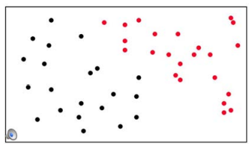
The Red and The Black
Notes:
Imagine that you were given all these points, and you needed to guess a function of their x, y coordinates that would have one output for the red ones and a different output for the black ones.

Slide 22
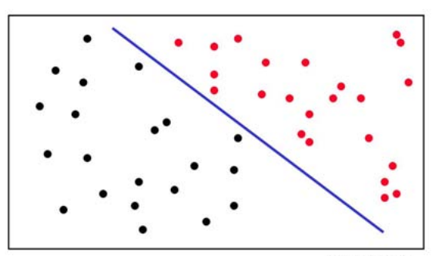
What’s the right hypothesis?
Notes:
In this case, it seems like you could do pretty well by defining a line that separates the two classes.

Slide 23
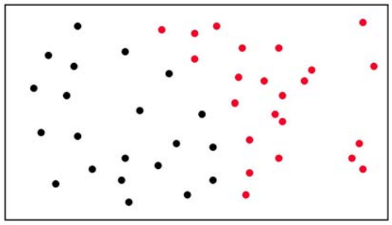
Now, what’s the right hypothesis?
Notes:
Now, what if we have a slightly different configuration of points? We can't divide them conveniently with a line.

Slide 24
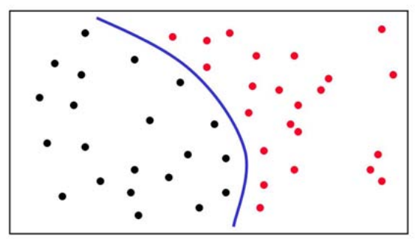
Now, what’s the right hypothesis?
Notes:
But this parabola-like curve seems like it might be a reasonable separator.

Slide 25
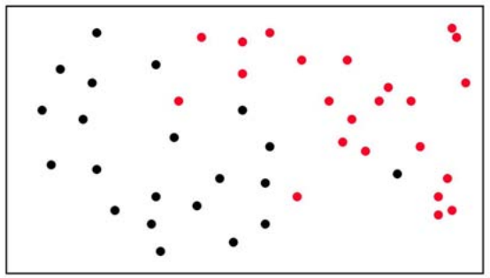
How about now?
Notes:
Now, what? This seems much trickier. There are at least a couple of reasonable kinds of answers.

Slide 26
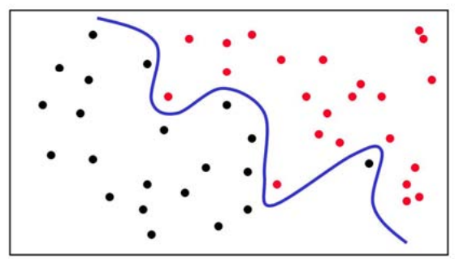
How about now? Answer 1
Notes:
Here's an answer. It successfully separates the reds from the blacks. But there's something sort of unsatisfactory about it. Most people have an intuition that it's too complicated.

Slide 27
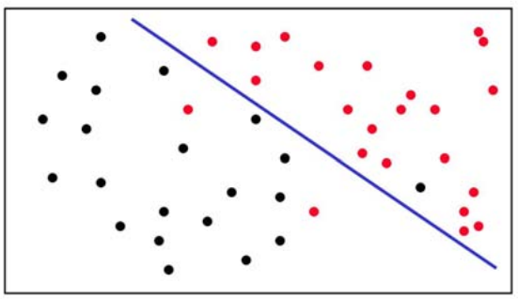
How about now? Answer 2
Notes:
Here's another answer. It's not a perfect separator; it gets some of the points wrong. But it's prettier.
In general, we will always be faced with making trade-offs between hypotheses that account for the data perfectly and hypotheses that are, in some sense, simple. There are some mathematical ways to understand these trade-offs; we'll avoid the math, but try to show you, intuitively, how they come up and what to do about them.

Slide 28
Variety of Learning Methods
Learning methods differ in terms of:
The form of the hypothesis
The way the computer finds a hypothesis given the data
Notes:
There are lots and lots of different kinds of learning algorithms. I want to show you cartoon versions of a couple of them first, and then we'll get down to the business of understanding them at a detailed algorithmic level.
The learning methods differ both in terms of the kinds of hypotheses they work with and the algorithms they use to find a good hypothesis given the data.

Slide 29
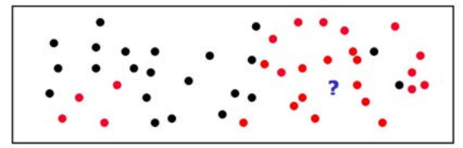
Nearest Neighbour
Remember all your data
When someone asks a question
Find the nearest old data point
Return the answer associated with it
Notes:
Here's the most simple-minded of all learning algorithms (and my personal favorite (which might imply something about me!)). It's called nearest neighbor (or lazy learning). You simply remember all the examples you've ever seen.
When someone asks you a question, you simply find the existing point that's nearest the one you were asked about, and return its class.
So, in this case, the nearest point to the query is red, so we'd return red.

Slide 30
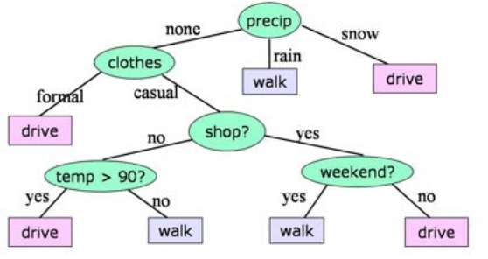
Decision Trees
Use all the data to build a tree of questions with answers at the leaves
Notes:
Another well-loved learning algorithm makes hypotheses in the form of decision trees. In a decision tree, each node represents a question, and the arcs represent possible answers. We can use this decision tree to find out what prediction we should make in the drive/walk problem.

Slide 31
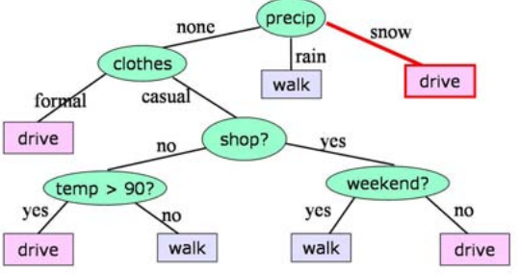
Decision Trees
Use all the data to build a tree of questions with answers at the leaves
Notes:
We'd start by asking what the current precipitation is. If it's snow, we just stop asking questions and

Slide 32
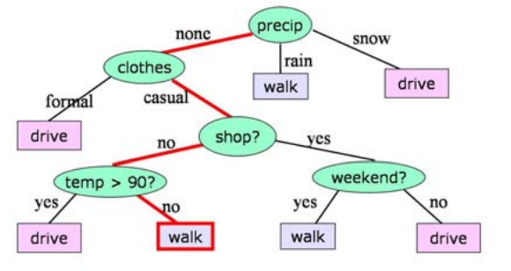
Decision Trees
Use all the data to build a tree of questions with answers at the leaves
Notes:
We can always continue asking and answering questions until we get to a leaf node of the tree; the leaf will always contain a prediction.
Hypotheses like this are nice for a variety of reasons. One important one is that they're relatively easily interpretable by humans. So, in some cases, we run a learning algorithm on some data and then show the results to experts in the area (astronomers, physicians), and they find that the learning algorithm has found some regularities in their data that are of real interest to them.

Slide 33
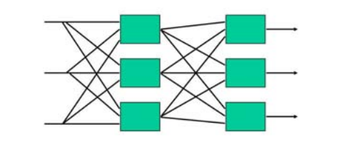
Neural Networks
Represent hypothesis as combinations of simple computations
Neurophysiologically plausible (sort of)
Learning through weight adjustment
Notes:
Most people have heard of neural networks. They can represent complicated hypotheses in high dimensional continuous spaces. They are attractive as a computational model because they are composed of many small computing units. They were motiviated by the structure of neural systems in parts of the brain. Now it is understood that they are not an exact model of neural function, but they have proved to be useful from a purely practical perspective.
In neural networks, the individual units do a simple, fixed computation that combines the values coming into them with "weights" on the arcs. The learning process consists of adjusting the weights on the arcs in reaction to errors made by the network.

Slide 34
Machine Learning Successes
Image Recognition
Natural Language Processing (NLP)
Recommendation Systems
Fraud Detection
Scientific Discovery
Drug Discovery
Climate Change Prediction
Steering an autonomous cars
Help analyse players performance.
Notes:
Machine learning methods have been successfully fielded in a variety of applications, including
Now, we'll roll up our sleeves, and see how all this is done.

Slide 35
Supervised Learning

Slide 36

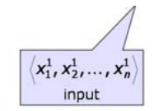
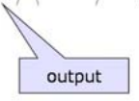

Supervised Learning
Given data (training set)
Goal: Find a hypothesis h in hypothesis class H that does a good job of mapping x to y
Notes:
A supervised learning problem is made up of a number of ingredients. The first is the data (sometimes called the training set). The data, D, is a set of m input-output pairs. We will write the ith element of the data set as xi , yi . In the context of our old running example, an xi would be a vector of values, one for each of the input features, and a yi would be an output value (walk or drive). Each xi is a vector of n values. We'll write xi j for the jth feature of the ith input-output pair. We'll consider different kinds of features. Sometimes we'll restrict ourselves to the case where the features are only 0s and 1s. Other times, we'll let them be choosen from a set of discrete elements (like "snow", "rain", "none"). And, still other times, we'll let them be real values, like temperature, or weight.
Similarly, the output, yi , might be a boolean, a member of a discrete set, or a real value. For a particular problem, the yi will all be of a particular type.
When yi is a boolean, or a member of a discrete set, we will call the problem a classification problem. When yi is real-valued, we call this a regression problem.
Now, the goal of learning will be to find a hypothesis, h, that does a good job of describing the relationship between the inputs and the outputs. So, a part of the problem specification is capital H, the hypothesis class. H is the set of possible hypotheses that we want our learning algorithm to choose from. It might be something like decision trees with 6 nodes, or lines in two-dimensional space, or neural networks with 3 components.

